Slide 1

Capstone project 1 presentation
Student: Nathan zhang
Mentor: Misael Manjarres

Slide 2
Project overview
Context Familiarization (10%)
Data Wrangling (35%)
Exploratory Analysis (30%)
In-Depth Analysis w/ ML (20%)
Result & Conclusion (5%)
* #’s in parenthesis represent time allocation

Slide 3

1. Context Familiarization
Zillow provides real estate information for consumers
Zillow wants to push the accuracy of home value estimates (Zestimate) further
Out goal is to predict residual errors, defined as log(Zestimate) - log(Sale Price)
Zillow does not provide actual residual errors from later transactions, so we will look at $R^{2}$ instead

Slide 4
1. Context Familiarization
Properties_2016.csv – all the homes with property features for 2016
Properties_2017.csv – all the homes with property features for 2017 (as of 10/2/2017)
Train_2016.csv – transaction data from 1/1/2016 to 12/31/2016
Train_2017.csv – transaction data from 1/1/2017 to 9/15/2017 (as of 10/2/2017)

Slide 5
1. Context Familiarization
Properties data includes homes in greater LA area (2,985,217)
Homes in Properties_2016 & _2017 are the same ones
Train data contains logerrors in each year (90,275 & 77,613)
We only use Properties data w/ corresponding logerrors (90,275 + 77,613)

Slide 6
2. Data wrangling
Identify different types of features
Numerical: #bedroom, #bathroom, basement size, etc.
Categorical: air conditioning system, construction type, architecture style, etc.
Other: transaction date, longitude & latitude, etc.
Find & handle missing values
Fill w/ 0’s: #fireplace, #pool, etc.
Fill w/ means: most numerical variables
Fill w/ ”missing”: most categorical variables

Slide 7
3. exploratory Analysis
Target variable
Numerical variable
Categorical variable
Other variable

Slide 8
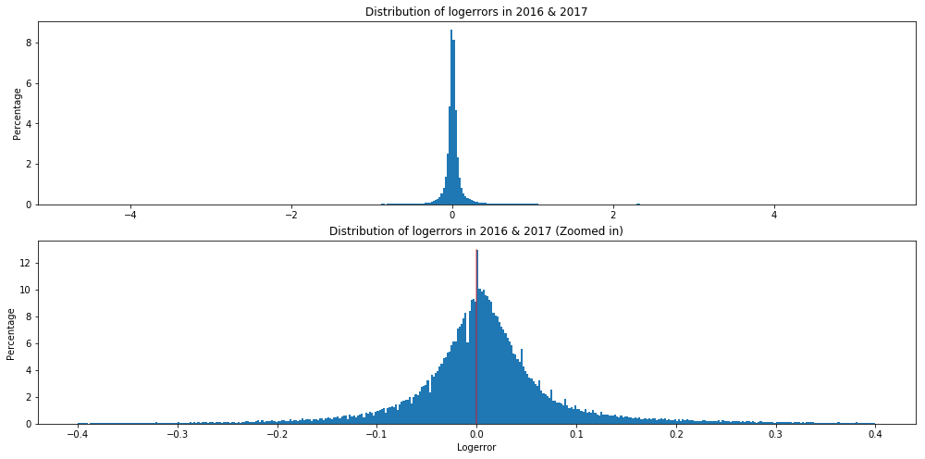
3. Exploratory Analysis Target variable
Mostly near zero
95% logerrors within ±.24
Thin but long tails
Only 0.4% logerrors > 1 or < -1
Max = 5.3, Min = -4.7
Slightly positive-skew

Slide 9
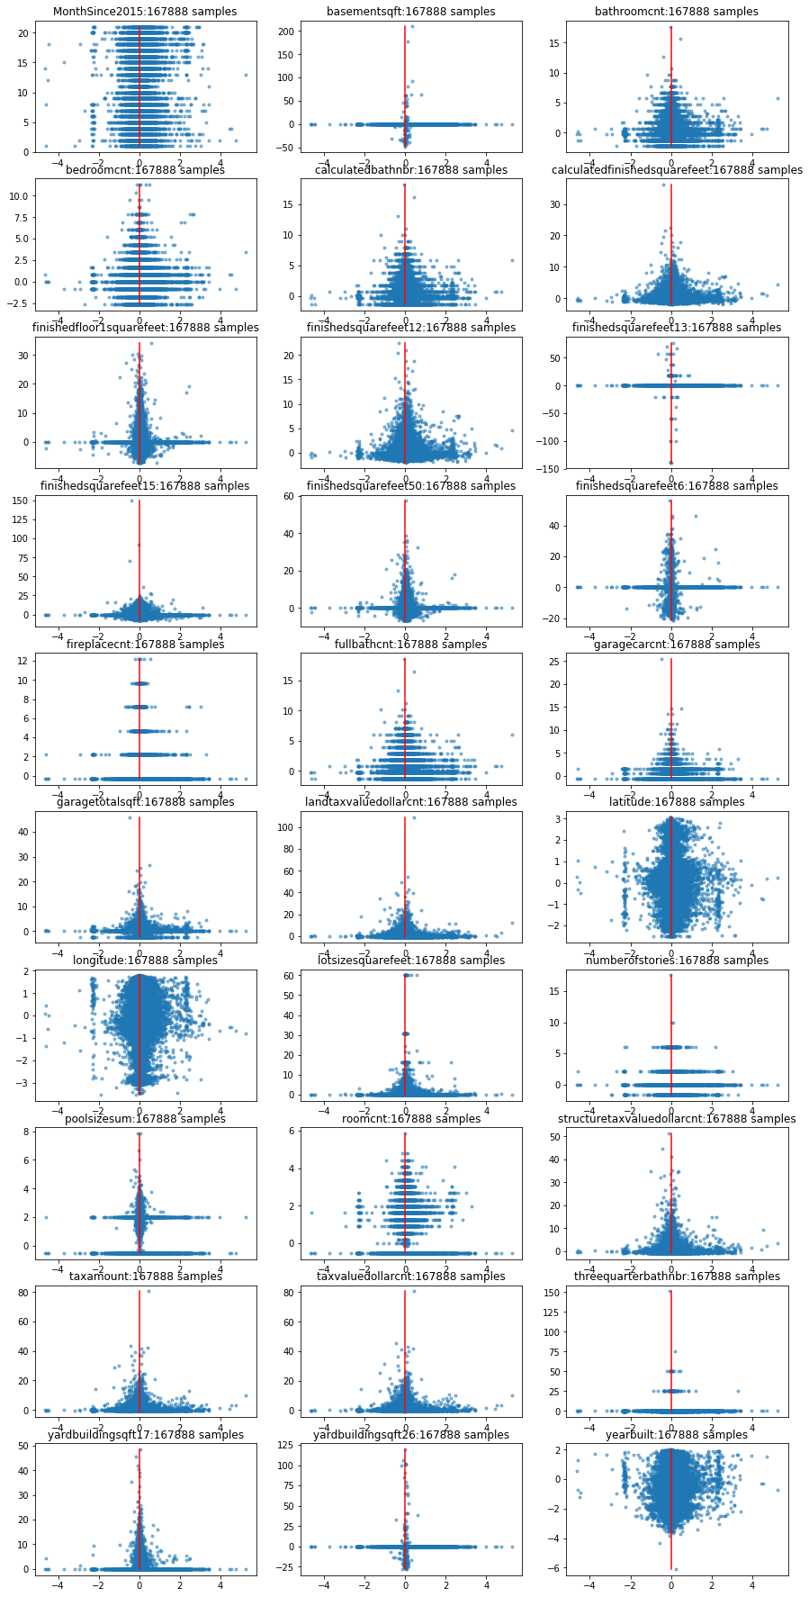
3. Exploratory Analysis Numerical variables
No obvious trend from visual
Very weak correlation w/ target variable
Due to large # of zero-ish values
Weak correlation between variables
20 variables w/ low p-value from OLS are selected

Slide 10
3. Exploratory Analysis CATEGORICAL
Created 3000+ dummies from 27 variables
Fitting OLS w/ a 167000 x 3000 data frame is a pain ☹
10 variables are statistically helpful
E.g. Pool, City, Building Quality Type, Class Type, etc.
They generate ~600 dummies

Slide 11
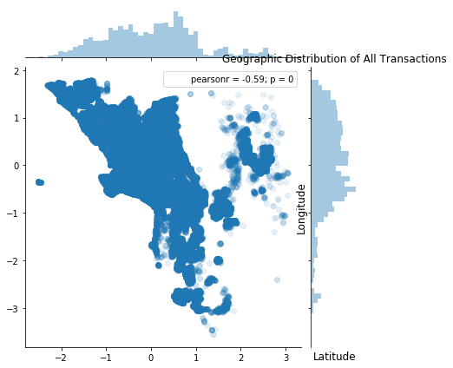
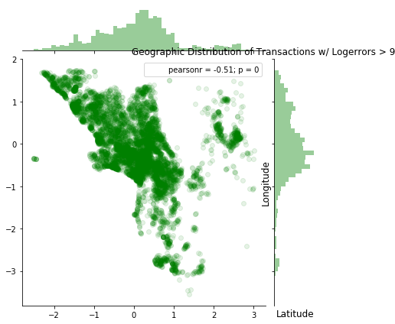
3. Exploratory Analysis OTHER
Longitude & Latitude
Not statistically helpful
Excluded from later analysis
Zip code is a better alternative
more specific and useful

Slide 12
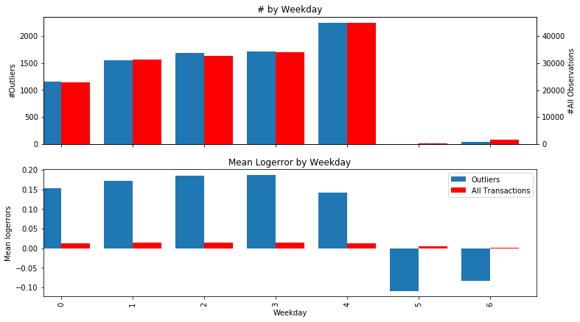
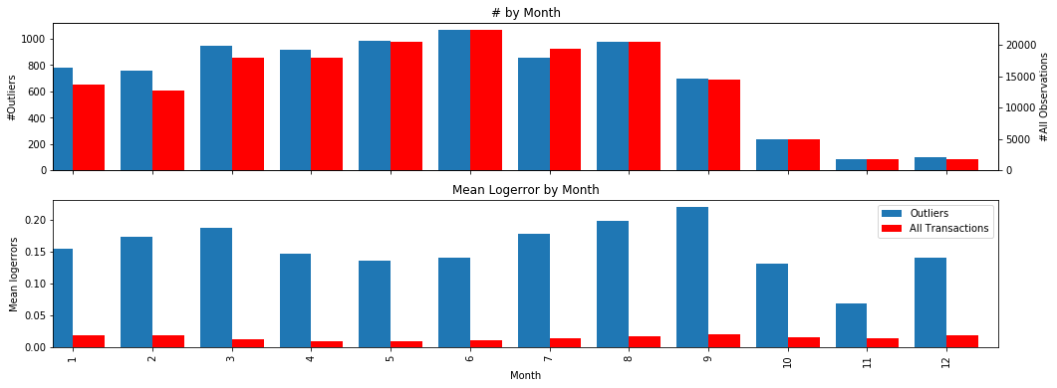
3. Exploratory Analysis OTHER
Transaction Date (extract 3 features)
Months_Since_2015
A time series factor reflect error inflation
Weekday_7, Q_2
2 categorical variables
Homes transacted on Sunday or during 2nd quarter are underestimated

Slide 13
3. Exploratory Analysis put all together
OLS w/ all numerical & categorical parameters (621 in total)
No significant trend can be identified
Hard to improve significantly w/o external data

Slide 14
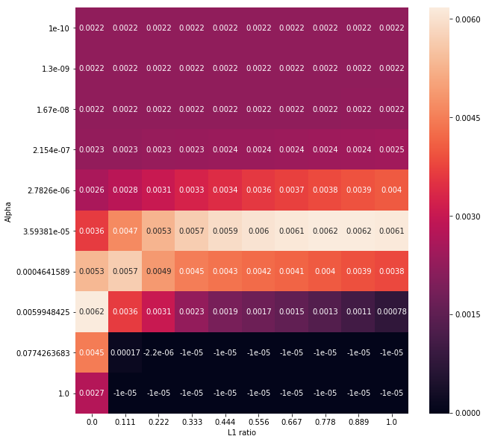
4. Machine learning Analysis
Split into train & test sets (70% vs 30%)
Stick to OLS for the nature of problem
Add L1 and L2 regularization (Elastic Net)
Hyperparameter tuning: Alpha & L1 Ratio
2-D Heat Map (took 17 hrs!)
Higher sensitivity to Alpha

Slide 15
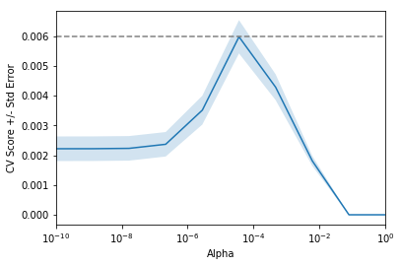
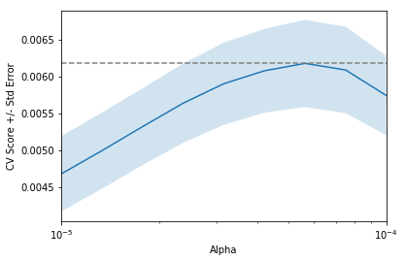

4. Machine learning Analysis
Alpha Tuning
We are more sensitive to Alpha
Only 10 values from 0 to ${10}^{−10}$ in a 10x10 grid
Further Tuning give us optimized Alpha = ${4.22∗10}^{−5}$
Best $R^{2}$ score is around .0061

Slide 16
5. Result & Conclusion
Conclusions
Found 25 parameters that can statistically help avoid mispricing
In most cases, Zestimate is a good estimate of home values
Outliers are almost inevitable by using current data
Suggestions
Look into the largest outliers and find the exact reasons of over- and under-valuation
Consider adding new features based on investigations
Encourage users to provide more information and avoid missing values

